Slide 1
BI Learning
2022-09-01

Slide 2
Object Oriented Programing OOP
Everything is Objects
Contains data
Maid of:
Properties
Methods
Notes:
Objects can contain data and code: data is in forms of fields (properties), and procedures (methods). Methods that are attached can modify properties of the objects. This is reference to oneself. Parents of modern OOP is Smaltalk and Simul.

Slide 3
Four Principles
Encapsulation
Abstraction
Inheritance
Polymorphism

Slide 4
Encapsulation
Contains private state
Modified through methods

Slide 5
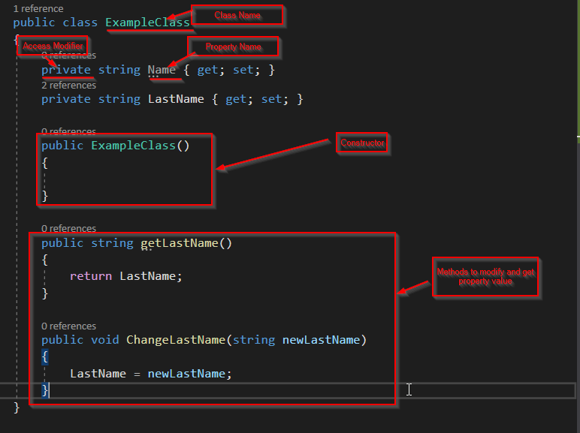

Slide 6
Abstraction
Extension of Encapsulation
Exposes state through methods
Doesn’t require to know what's inside

Slide 7
Inheritance
Ability to acquire properties of other objects
Allows to invoke parent methods
Protected
Sealed
Base

Slide 8
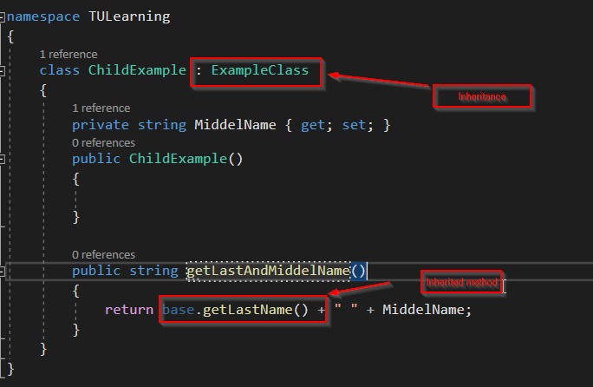

Slide 9
Polymorphism
One Method – many Shapes
Overloading
Overriding
Virtual

Slide 10
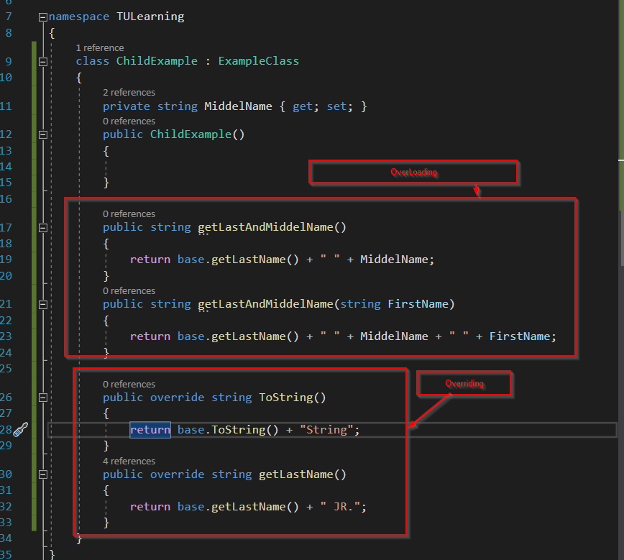
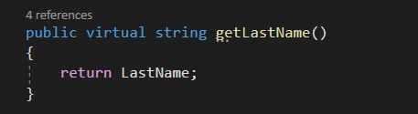

Slide 11
Linked list
Data structure
Linear Collection
Element: Node
References next
Distributed in memory

Slide 12
